Slide 1
16/03/2022
Title: Intro to Algebra
Aims:
Be able to
add and subtract ‘like’ terms.
Use the DPM/A to expand bracketed terms.
Plan:
Daily review:
Directed number.
Number rules revisited.
Simplify expressions.
Need whiteboards

Slide 2

Daily review – Directed number.
Same signs add – different signs subtract
Rewrite the following expressions, only simplifying the double signs.
3 – (-2) = 3 + 2
$x$ – (-$y$) = $x$ +$y$
5 + (-4) = 5 – 4
$x$ + (-$y$) = $x$ –$y$
-4 – (-5) = -4 + 5
$−x$ – (-$y$) = -$x$ +$y$
-6 + (-2) = -6 – 2
-$x$ + (-$y$) = -$x$ –$y$

Slide 3
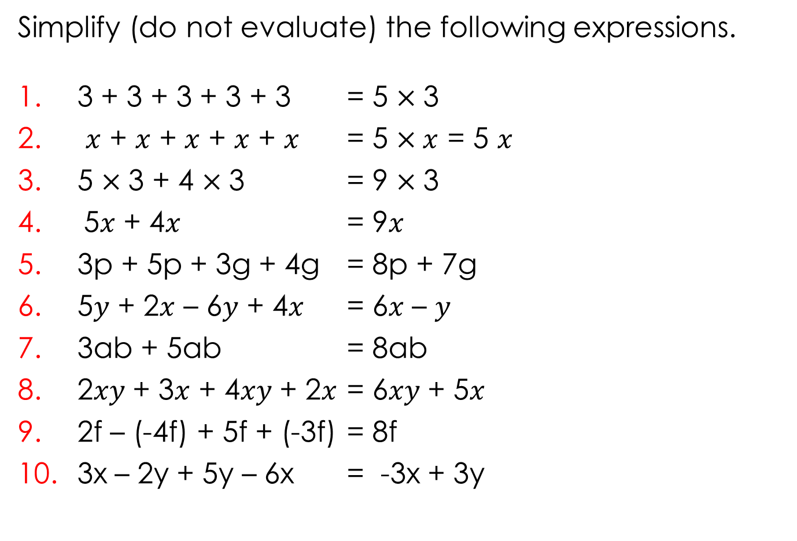
Daily review – Number rules.
Simplify (do not evaluate) the following expressions.
3 + 3 + 3 + 3 + 3 = 5 $×$3
$x$ + $x$ + $x$ + $x$ + $x$ = 5 $×x$ = 5 $x$
5 $×$3 + 4 $×$3 = 9 $×$3
5$x$ + 4$x$ = 9$x$
3p + 5p + 3g + 4g = 8p + 7g
5$y$ + 2$x$ – 6$y$ + 4$x$ = 6$x$ – $y$
3ab + 5ab = 8ab
2$xy$ + 3$x$ + 4$xy$ + 2$x$ = 6$xy$ + 5$x$
2f – (-4f) + 5f + (-3f) = 8f
3x – 2y + 5y – 6x = -3x + 3y

Slide 4
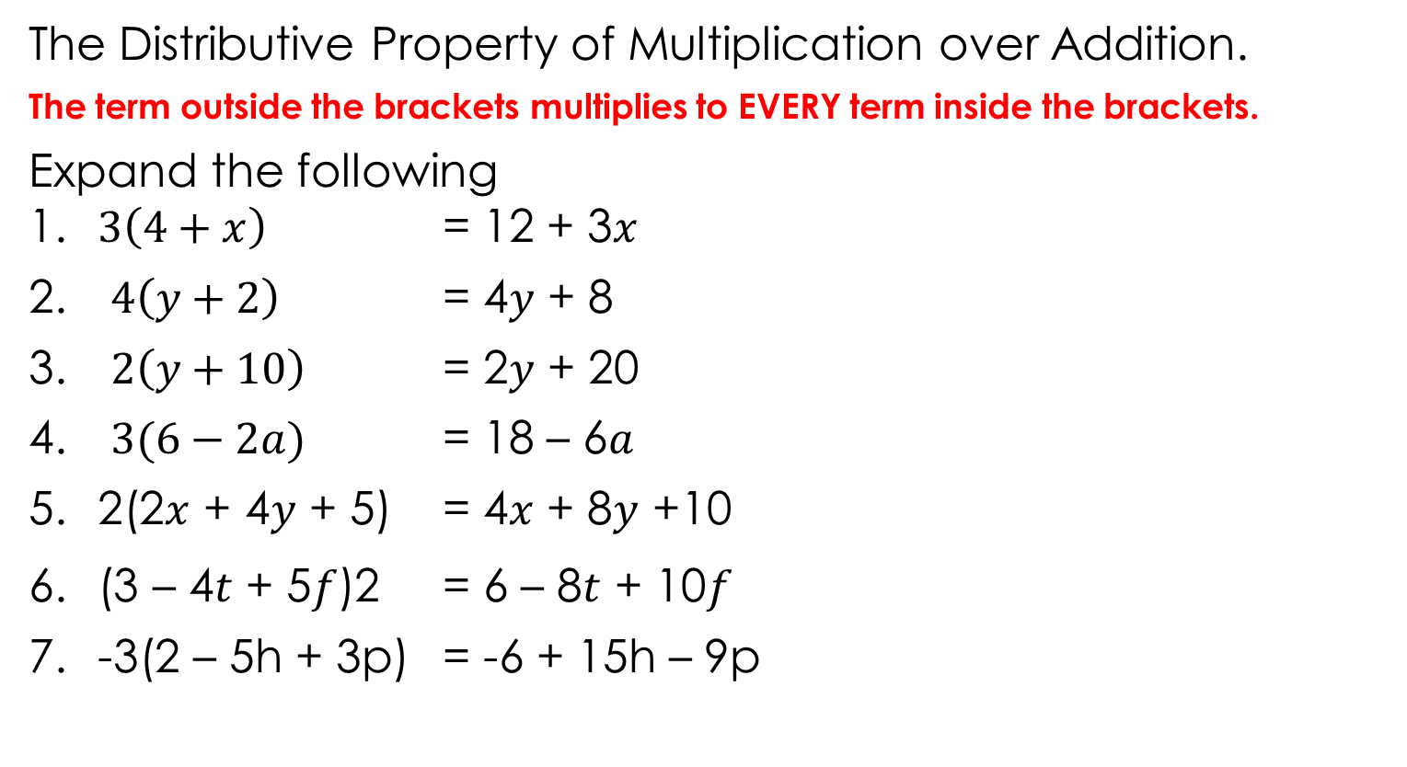
The Distributive Property of Multiplication over Addition.
The term outside the brackets multiplies to EVERY term inside the brackets.
Expand the following 1. $3\left(4+x\right)$ = 12 + 3$x$
$4\left(y+2\right)$ = 4$y$ + 8
$2\left(y+10\right)$ = 2$y$ + 20
$3(6−2a)$ = 18 – 6$a$
2(2$x$ + 4$y$ + 5) = 4$x$ + 8$y$ +10
(3 – 4$t$ + 5$f$)2 = 6 – 8$t$ + 10$f$
-3(2 – 5h + 3p) = -6 + 15h – 9p
Notes:
Student worksheet

Slide 5
Whiteboards
4(2x + 4)
2(4f – 2)
3(2 – 3e)
10(2s +3)
x(x + 3)
4(2d + 4r – 3)

Slide 6
The word is
Pronumeral
A letter or symbol used in place of a number
Pronumerals represent numbers, so they MUST follow the same rules as numbers.

Slide 7
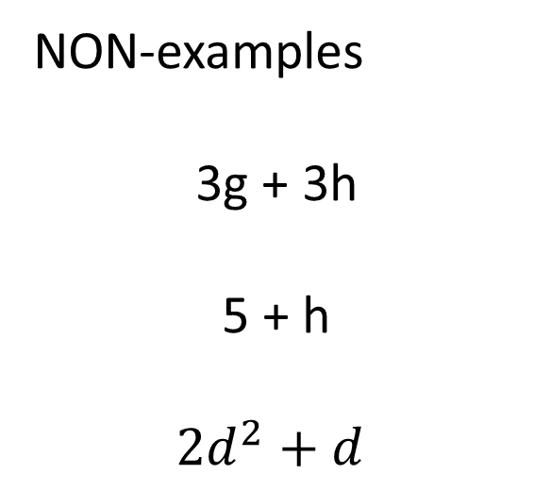
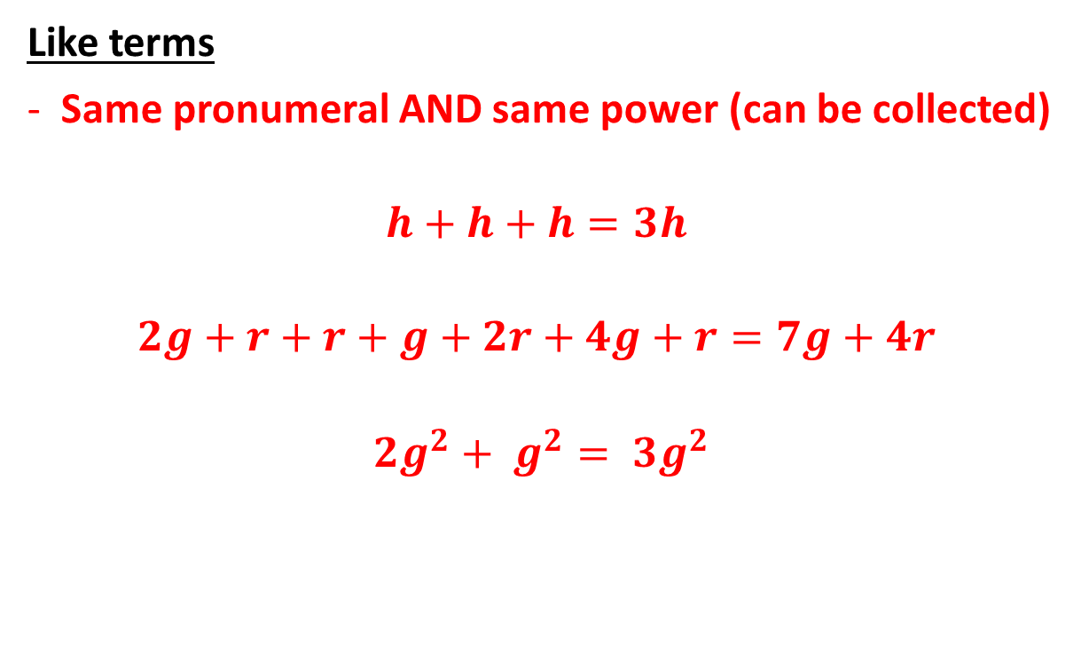
Terminology
Like terms
Same pronumeral AND same power (can be collected)
$$h+h+h=3h$$
$$2g+r+r+g+2r+4g+r=7g+4r$$
$${2g}^{2}+ g^{2}= {3g}^{2}$$
NON-examples
3g + 3h
5 + h
$${2d}^{2}+d$$

Slide 8
Practise
Practise
Practise

Slide 9
Reflection – Fist to 5
Aims:
Be able to
add and subtract ‘like’ terms.
Use the DPM/A to expand bracketed terms.

